Slide 1
Chapter-6
Capital Budgeting Analysis (N- 20 marks) case chapter

Slide 2
Concept of Capital budgeting
Capital budgeting is finance terminology for the process of deciding whether or not to undertake an investment project. It is the project selection exercise performed by the business enterprise.
Capital budgeting is the process of acquiring the fixed assets or process of investment in capital projects.
The process of capital budget includes the identification of the investment opportunity estimation of relevant cost and benefits of the identified projects, evaluating of the projects approval and monitoring of the project.
It is the process a business undertakes to evaluate potential major projects or investments. Construction of a new plant or a big investment in an outside venture are examples of projects that would require capital budgeting before they are approved or rejected.

Slide 3
Significance/ features of capital budgeting
Unchanged decision
Growth
Large amount of funds
Risk
Complex
National importance
Meaning of Independent and mutually exclusive project
Independent project are those projects that are not related or not compete for the project resources. Project A as well as B can be selected if both are worth undertaking. For example, buying a car and buying a computer.
Mutually exclusive projects are those projects which cannot accepted simultaneously. Either A or B can be selected but not both. For example buying a Samsung mobile or buying Apple mobile.

Slide 4
Method /Techniques of capital budgeting Decision
Non Discounted cash flow method or traditional method
Discounted cash flow method/ modern method
Payback Period(PBP)
Discounted Payback Period(DPBP)
ii. Net present value(NPV)
ii. Average rate of return/ Accounting rate of return(ARR)
iii. Internal Rate of Return
iv. Modified Internal Rate of Return(MIRR)
v. Profitability Index(PI)

Slide 5
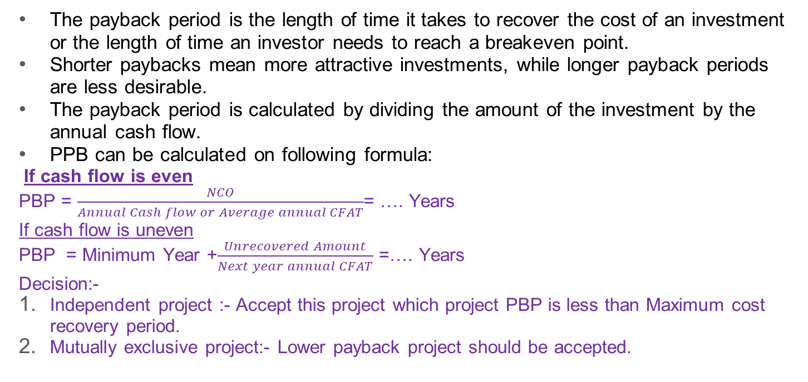
1. Payback period(PBP)
The payback period is the length of time it takes to recover the cost of an investment or the length of time an investor needs to reach a breakeven point.
Shorter paybacks mean more attractive investments, while longer payback periods are less desirable.
The payback period is calculated by dividing the amount of the investment by the annual cash flow.
PPB can be calculated on following formula:
If cash flow is even
PBP = $\frac{NCO}{Annual Cash flow or Average annual CFAT}$= …. Years
If cash flow is uneven
PBP = Minimum Year +$\frac{Unrecovered Amount}{Next year annual CFAT}$ =…. Years
Decision:-
Independent project :- Accept this project which project PBP is less than Maximum cost recovery period.
Mutually exclusive project:- Lower payback project should be accepted.
Advantages of PBP
Easy to understand and use
Helps in Reducing the Risk Of losses
Disadvantages
Does not consider the time value of money
Ignore the salvage and economic life of the project.

Slide 6
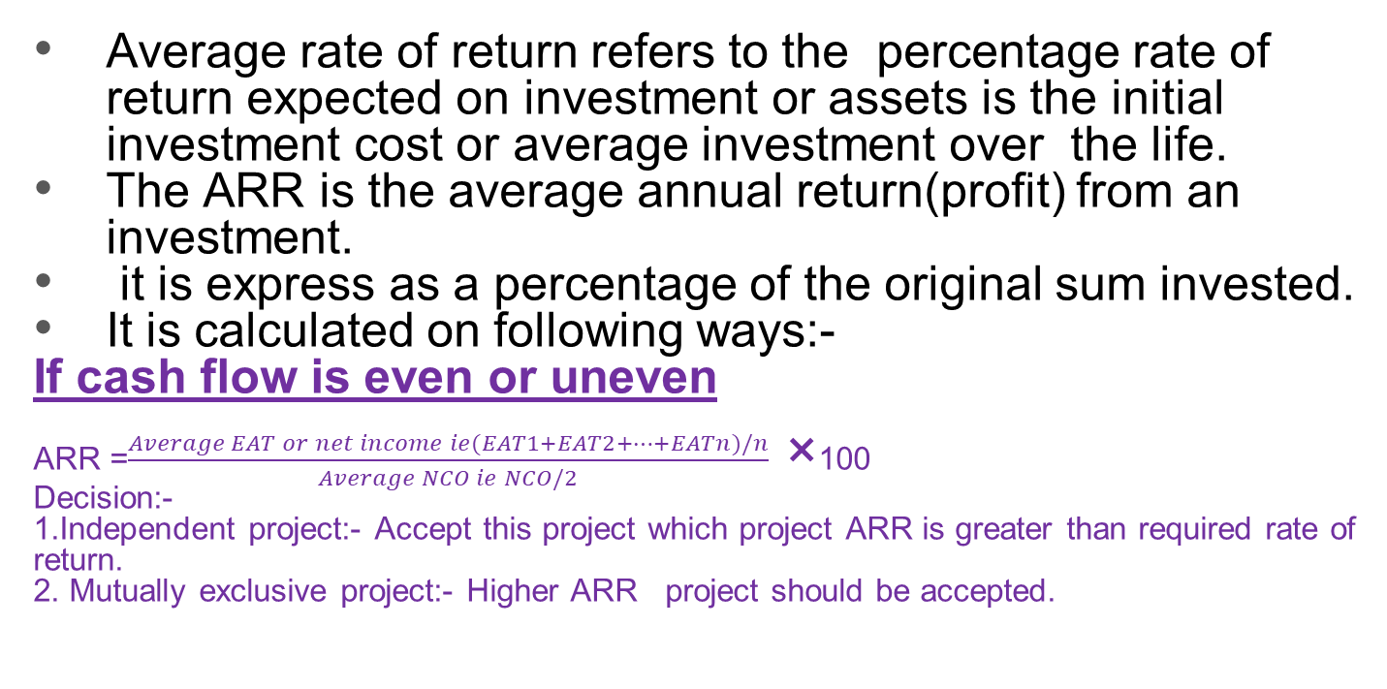
2.Average Rate of return(ARR)
Average rate of return refers to the percentage rate of return expected on investment or assets is the initial investment cost or average investment over the life.
The ARR is the average annual return(profit) from an investment.
it is express as a percentage of the original sum invested.
It is calculated on following ways:-
If cash flow is even or uneven
ARR =$\frac{Average EAT or net income ie(EAT1+EAT2+…+EATn)/n}{Average NCO ie NCO/2}$ ×100
Decision:-
1.Independent project:- Accept this project which project ARR is greater than required rate of return.
2. Mutually exclusive project:- Higher ARR project should be accepted.
Advantages of ARR
Accounting information is readily available, so easy to calculate
Simple to use and understand

Slide 7
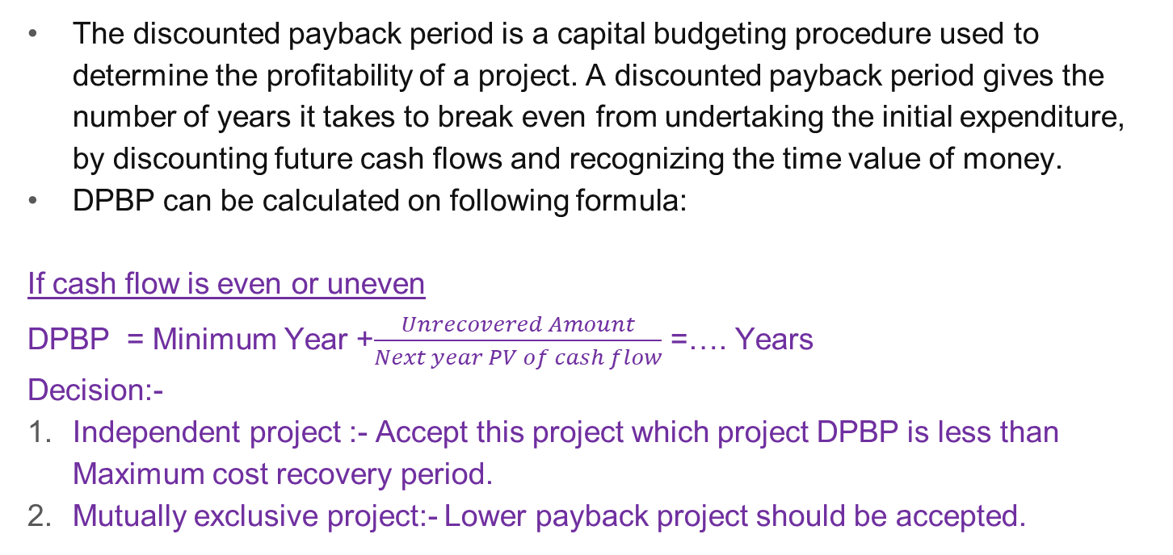
3 . DiscountedPayback period(DPBP)
The discounted payback period is a capital budgeting procedure used to determine the profitability of a project. A discounted payback period gives the number of years it takes to break even from undertaking the initial expenditure, by discounting future cash flows and recognizing the time value of money.
DPBP can be calculated on following formula:
If cash flow is even or uneven
DPBP = Minimum Year +$\frac{Unrecovered Amount}{Next year PV of cash flow}$ =…. Years
Decision:-
Independent project :- Accept this project which project DPBP is less than Maximum cost recovery period.
Mutually exclusive project:- Lower payback project should be accepted.
Advantages of DPBP
Consider the time value of money
Consider the risk factor
Disadvantages
DPBP method fails to determine whether the investment made will increase the firm’s value or not.
Complex calculation

Slide 8
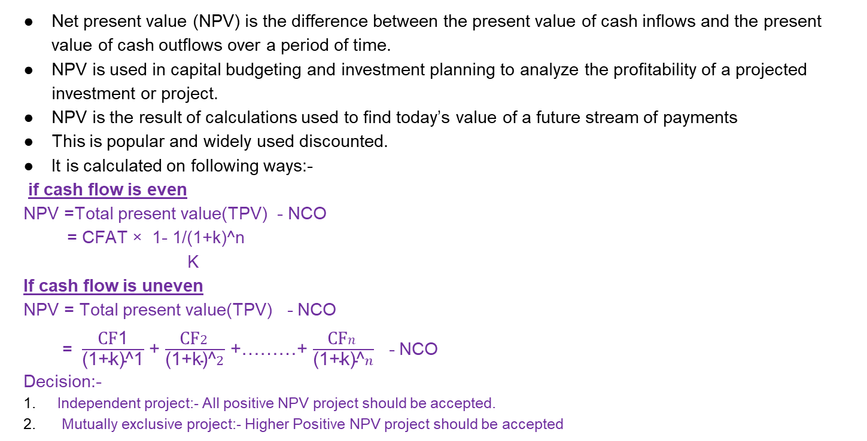
4. Net present value(NPV)
Net present value (NPV) is the difference between the present value of cash inflows and the present value of cash outflows over a period of time.
NPV is used in capital budgeting and investment planning to analyze the profitability of a projected investment or project.
NPV is the result of calculations used to find today’s value of a future stream of payments
This is popular and widely used discounted.
It is calculated on following ways:-
if cash flow is even
NPV =Total present value(TPV) - NCO
= CFAT × 1- 1/(1+k)^n
K
If cash flow is uneven
NPV = Total present value(TPV) - NCO
= $\frac{\text{CF}\text{1}}{\text{(}\text{1}\text{+}\text{k}\text{)^}\text{1}}$ + $\frac{\text{CF}2}{\text{(}\text{1}\text{+}\text{k}\text{)}\text{^}2}$ +………+ $\frac{\text{CF}n}{\text{(}\text{1}\text{+}\text{k}\text{)}\text{^}n}$ - NCO
Decision:-
Independent project:- All positive NPV project should be accepted.
Mutually exclusive project:- Higher Positive NPV project should be accepted
Advantages of NPV
Simple to use
Consider the time value of money
Consider the risk factor
Gives ranking information about projects
Determines the investment values
Reinvestment assumption
Measurement of profitability
Disadvantages
Forecasting errors
Minimum contribution to shareholder wealth
Depends upon on discount rates
Incomparable for different size of project.

Slide 9
Advantages of Net Present Value (NPV) –
1 Simple to Use: The net present value method is easy to apply to a real business project if the cash flows and discount rate are known.
2. Provides Time Value of Money: This method takes into consideration the effect of inflation on the future profitability of the project, thus estimating the time value of money.
3. Customization: In NPV, the discount rate can be adjusted according to the risk prevailing in the industry, along with various other factors, to obtain an appropriate output.
4. Determines Investment Value: The earnings throughout the project’s life span can be acquired by using the NPV method, which facilitates the company to know the future value of a specific investment.
5. Comparable: It facilitates the comparison of values generated in the future, by two or more similar projects to find out the most feasible option.
6. Comprehensive Method: It finds the present value of a project by examining the effect of various factors like risk, cash outflows, and inflows.
7. Measures Profitability: It is one of the most proficient methods of determining the actual profitability of a project in its lifetime.
8. Identifies Risk: In the absence of NPV, the managers would fail to estimate the risk of loss or meagre profitability in case of a long-lived project. It is otherwise possible by identifying the project with negative or zero NPV.
9. Reinvestment Assumption: The net present value is quite logical since, here the cash flows are not expected to be reinvested in the financial market, as done in the internal rate of return.
Disadvantages of Net Present Value (NPV)
1. Forecasting Errors: While assessing the viability of a long-lived project, the estimation of cash flows may not be that accurate for the later years.
2. Minimum Contribution to Shareholder’s Value: The shareholder’s value maximization is the result of the overall growth of a company, whereas a high NPV contributes little towards it.
3. Depends Upon Discount Rates: Since this method is based on discount rates, even a slight change may result in an entirely different NPV.
4. Neglects Sunk Cost: The sunk cost like research and development, trial, etc. incurred before the project starts, is mostly high. This cost is wholly ignored under the computation of NPV.
5. No Effect on EPS and ROE: Often, the projects with high NPV but the short duration may not enhance the earning per share and return on equity.
6. Incomparable for Differing Project Size: The concept of capital rationing is applied in NPV; therefore, the projects which do not lie under the capital budget limit cannot be compared under this method.

Slide 10
5.Internal Rate of Return(IRR)
The internal rate of return (IRR) is the annual rate of growth that an investment is expected to generate.
It is the rate of return at which the NPV of a project becomes zero in a discounted cash flow analysis.
The IRR is the discounted rate that makes the PV of cash flows equal to the PV of the cash outflows of the project.
IRR can be calculated on following ways:
If cash flow is even and uneven cash flow
for actual IRR one NPV is positive and another NPV is negative [ note i.if NPV required positive we must try at lower rate ii. If NPV required negative we must try at higher rate iii. The difference rate must be 5% ie (Higher rate – lower rate)]
Now NPV at LR = Positive value
NPV at HR = negative value

Slide 11
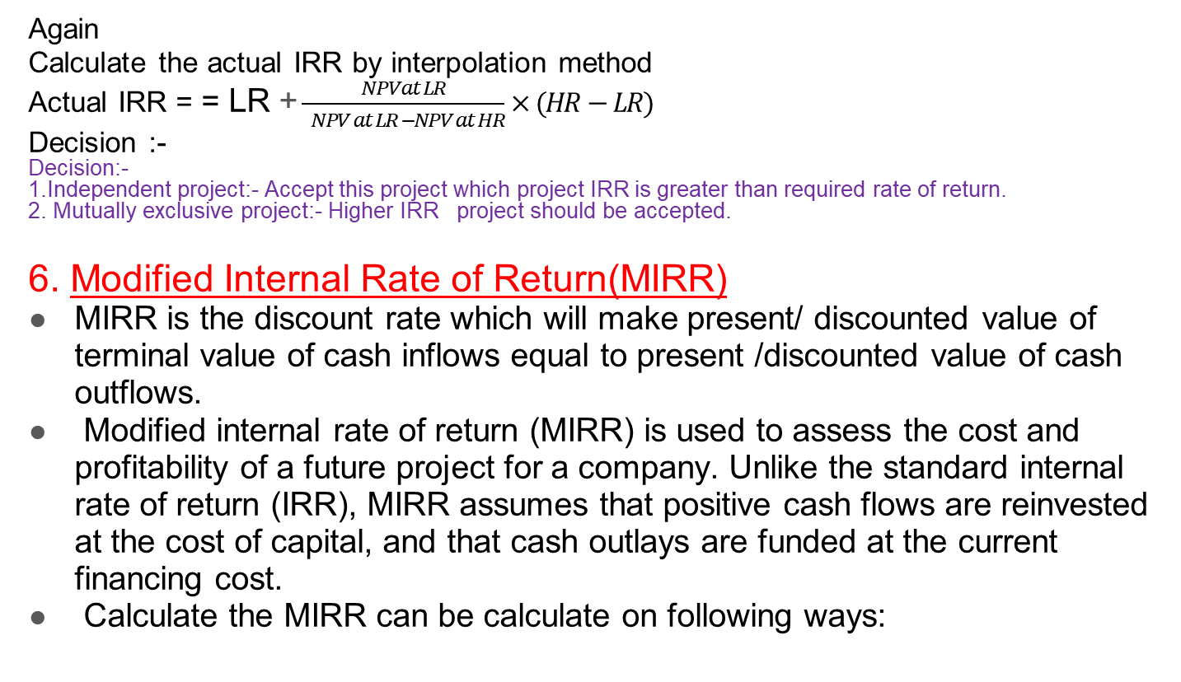
Advantages of IRR
Easy to understand and use
Consider the time value of money
Hurdle rate not required
Disadvantages
Ignore the size of project
Ignore the future benefits
Ignore the reinvestment rate
Again
Calculate the actual IRR by interpolation method
Actual IRR = = LR + $\frac{NPVat LR}{ NPV at LR −NPV at HR}×(HR−LR)$
Decision :-
Decision:-
1.Independent project:- Accept this project which project IRR is greater than required rate of return.
2. Mutually exclusive project:- Higher IRR project should be accepted.
6. Modified Internal Rate of Return(MIRR)
MIRR is the discount rate which will make present/ discounted value of terminal value of cash inflows equal to present /discounted value of cash outflows.
Modified internal rate of return (MIRR) is used to assess the cost and profitability of a future project for a company. Unlike the standard internal rate of return (IRR), MIRR assumes that positive cash flows are reinvested at the cost of capital, and that cash outlays are funded at the current financing cost.
Calculate the MIRR can be calculate on following ways:

Slide 12
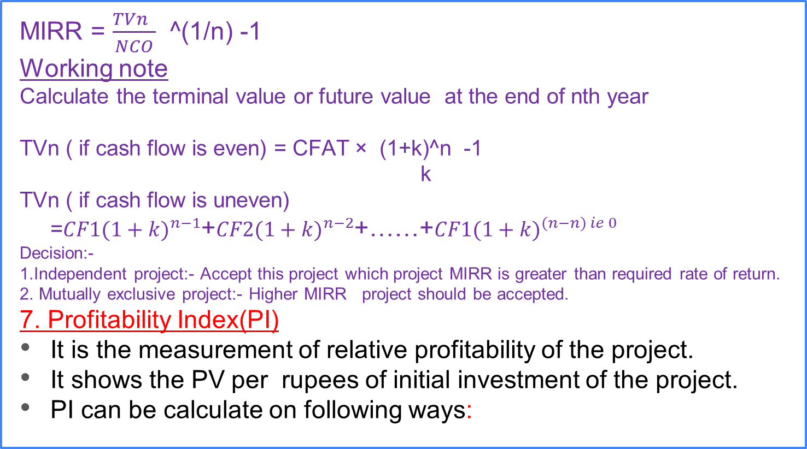
MIRR = $\frac{TVn }{NCO}$ ^(1/n) -1
Working note
Calculate the terminal value or future value at the end of nth year
TVn ( if cash flow is even) = CFAT × (1+k)^n -1
k
TVn ( if cash flow is uneven) =${CF1(1+k)}^{n−1}$+${CF2(1+k)}^{n−2}$+……+${CF1(1+k)}^{(n−n) ie 0}$
Decision:-
1.Independent project:- Accept this project which project MIRR is greater than required rate of return.
2. Mutually exclusive project:- Higher MIRR project should be accepted.
7. Profitability Index(PI)
It is the measurement of relative profitability of the project.
It shows the PV per rupees of initial investment of the project.
PI can be calculate on following ways:

Slide 13

If cash flow is even or uneven
PI = $\frac{TPV}{NCO}$
Decision
Independent project:- Accept this project which project PI is equal or greater than 1.
Mutually exclusive project:- Higher PI project should be accept.

Slide 14
When we calculate the capital budgeting we must consider the following four points
1. Identify the inflow, outflow, even and uneven cash flows
For example
hear
project X = even cash flow due to the same inflow or return
Project Y = uneven cash flow due to the different inflow
Inflows = year 1 to 4
Net cash outlay(NCO)/ outflow/ initial cost of investment = year 0
2. When we calculate the PBP,DPBP,NPV,IRR,MIRR and PI use net cash flow or CFAT
When we calculate the ARR use EAT or net income cash flow
3. Decision
PBP and DPBP Select lower year project
ARR,NPV,IRR,MIRR and PI Select higher value or rate project
Year | Net cash flow of project X ie CFATx | Net cash flow of project Y ie CFATy
0 1 2 3 4 | (Rs 10,000) 6000 6000 6000 6000 | (Rs 20,000) 10,000 15,000 9,000 12,000

Slide 15
4. Identify the income statement format
Particulars | Amount
Sales Less:- operating cost Earning Before Depreciation and Taxes(EBDT) Less: Depreciation Earning before Taxes(EBT) Less: tax amount ie (…% of EBT) Earning after tax or net income(EAT or net Income) Add:-Back Depreciation Net income cash flow or CFAT | ****** ****** ****** ****** ****** ****** ****** ****** *******

Slide 16
The End

